Slide 1
«ЭРУДИТ»
КОНКУРС ПО АНГЛИЙСКОМУ ЯЗЫКУ

Slide 2
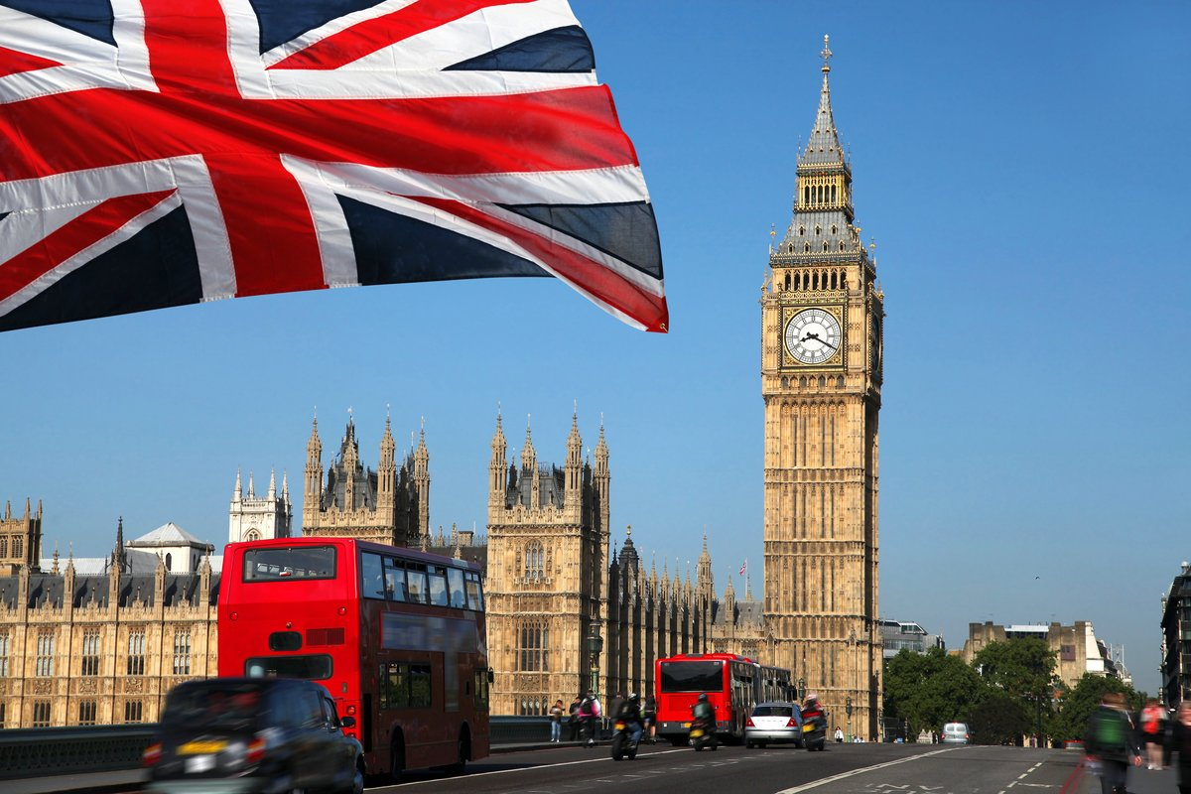
№ 1
WRITE 5 ENGLISH-SPEAKING COUNTRIES

Slide 3
№ 2
ANSWER THE QUESTIONS
How many letters are there in the English alphabet?
What language is spoken in France? Germany? China?
Who was the first cosmonaut?
What is the capital of the UK?

Slide 4
№ 3
WRITE ALL THE PROFESSIONS YOU KNOW

Slide 5
№ 4
Odd one out.
ruler rubber pencil ball
schoolbag desk Geography pencil case
desk blackboard chair pen
paperclip pen crayon pencil

Slide 6
№ 5
Put the words into the right columns.
map ruler microscope PC trainers
water colours globe magnet ball brush
IT | PE | ART | GEOGRAPHY | SCIENCE | MATHS

Slide 7
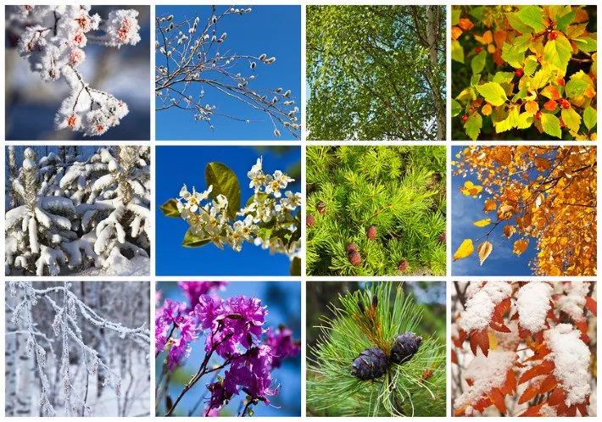
№ 6
What month is it? Write the word.
1) This is the fifth month of the year. –
2) This is the last month of the year. –
3) This is the only month with letter “g” in it. –
4) The last letter of the month is “e”. –
5) This is the first month of the year. –
6) This is the third month of the year. –

Slide 8
№ 7
Put the words into the right form and columns
cap scarf watch bicycle wolf atlas notepad ruler
boy lady dress knife fox camp bus pen country
- S | - ES | - IES | - VES

Slide 9
№ 8
Match the dates and celebrations.
Halloween December 25
St Patrick's Day November 5
Guy Fawkes Day February 14
May Day October 31
Christmas May 1
St Valentine's Day March 17

Slide 10
№ 9
Complete the sentences with the right words.
1) We keep cups and dishes in a …
2) We keep jeans and skirts in a . ..
3) We keep books on a . ..
4) We make a meal on a ….
5) We wash face and things in a ….

Slide 11
№ 10 What is this?

